Slide 1
Generative graph models

Slide 2
Overview
What is a generative graph model?
Traditional graph generation methods
Deep generative models
Graphs as sequences
GraphRNN
Evaluation

Slide 3
What is a graph generative model?

Slide 4
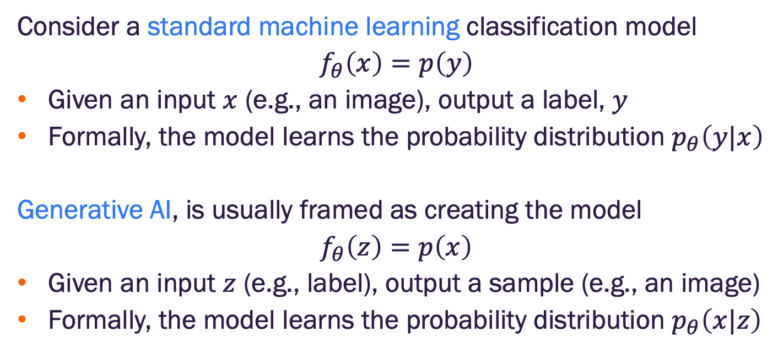
What is a generative AI model?
Consider a standard machine learning classification model
$$f_{θ}\left(x\right)=p\left(y\right)$$
Given an input $x$ (e.g., an image), output a label, $y$
Formally, the model learns the probability distribution $p_{θ}\left(y|x\right)$
Generative AI, is usually framed as creating the model
$$f_{θ}\left(z\right)=p\left(x\right)$$
Given an input $z$ (e.g., label), output a sample (e.g., an image)
Formally, the model learns the probability distribution $p_{θ}\left(x|z\right)$
Are these paradigms fundamentally different?

Slide 5
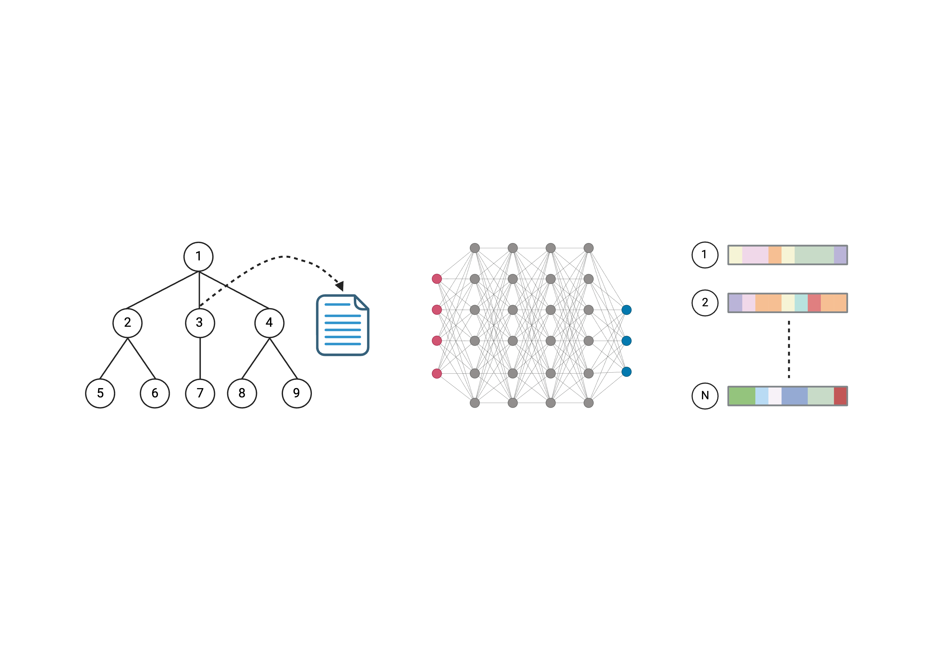

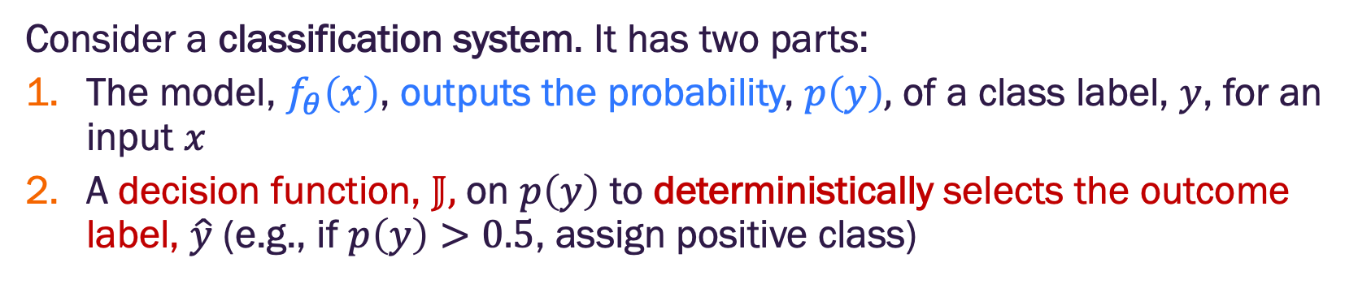
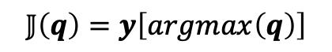
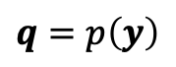
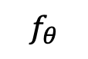
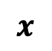
What is a generative AI model?
Consider a classification system. It has two parts:
The model, $f_{θ}\left(x\right)$, outputs the probability, $p\left(y\right),$ of a class label, $y$, for an input $x$
A decision function, $𝕁,$ on $p\left(y\right)$ to deterministically selects the outcome label, $\hat{y}$ (e.g., if $p\left(y\right)>0.5$, assign positive class)
$$x$$
$$q=p\left(y\right)$$
$$y$$
$$f_{θ}$$
0
1
1
0
1
0.1
0.2
0.2
0.4
0.1
cat
dog
fish
horse
snake
$$𝕁\left(q\right)=y\left[argmax\left(q\right)\right]$$
Example deterministic
decision function

Slide 6

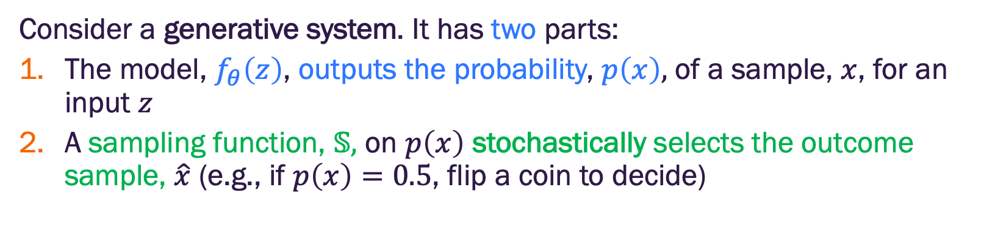
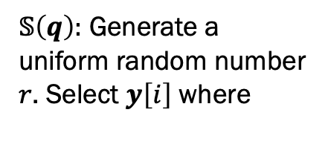
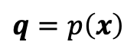
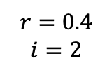
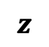
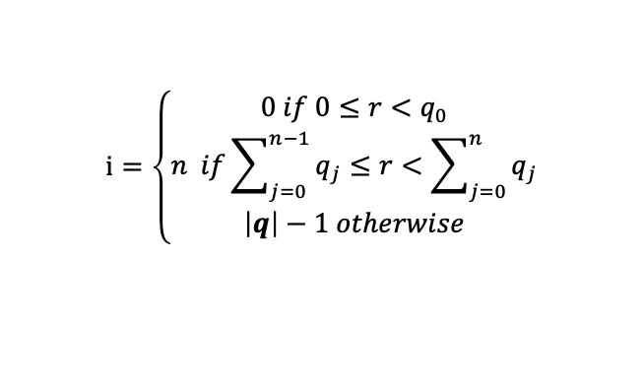
What is a generative AI model?
Consider a generative system. It has two parts:
The model, $f_{θ}\left(z\right)$, outputs the probability, $p\left(x\right),$ of a sample, $x$, for an input $z$
A sampling function, $𝕊,$ on $p\left(x\right)$ stochastically selects the outcome sample, $\hat{x}$ (e.g., if $p\left(x\right)=0.5$, flip a coin to decide)
$$z$$
$$q=p\left(x\right)$$
Example stochastic sampling function
$$x$$
$$f_{θ}$$
0
1
1
0
1
0.1
0.2
0.2
0.4
0.1
cat
dog
fish
horse
snake
$$r=0.4$$
$$i=2$$
$𝕊\left(q\right):$ Generate a uniform random number $r$. Select $y\left[i\right]$ where
$$i=\left\{\begin{matrix}0 if 0≤r<q_{0} \\ n if\sum_{j=0}^{n−1}{q_{j}}≤r<\sum_{j=0}^{n}{q_{j}} \\ \left|q\right|−1 otherwise\end{matrix}\right.$$

Slide 7
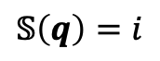
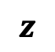
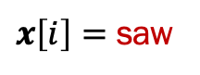
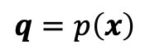
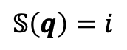
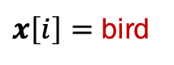
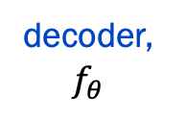
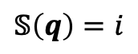
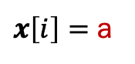
What is a generative AI model?
Example: Generative language model
encoder
$$z$$
decoder, $f_{θ}$
$$q=p\left(x\right)$$
0
1
1
0
1
0.1
0.2
0.2
0.4
0.1
The cat
$$𝕊\left(q\right)=i$$
$x\left[i\right]=$ saw
0
0
1
1
0
0.1
0.3
0.2
0.2
0.2
The cat saw
$$𝕊\left(q\right)=i$$
$x\left[i\right]=$ a
1
1
1
1
0
0.1
0.5
0.1
0.2
0.1
The cat saw a
$$𝕊\left(q\right)=i$$
$x\left[i\right]=$ bird

Slide 8
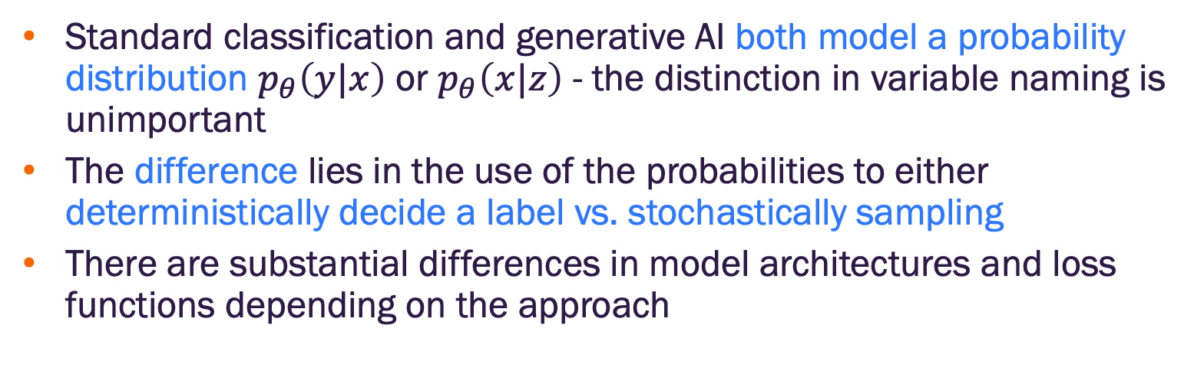
What is a generative AI model?
Standard classification and generative AI both model a probability distribution $p_{θ}\left(y|x\right)$ or $p_{θ}\left(x|z\right)$ - the distinction in variable naming is unimportant
The difference lies in the use of the probabilities to either deterministically decide a label vs. stochastically sampling
There are substantial differences in model architectures and loss functions depending on the approach

Slide 9


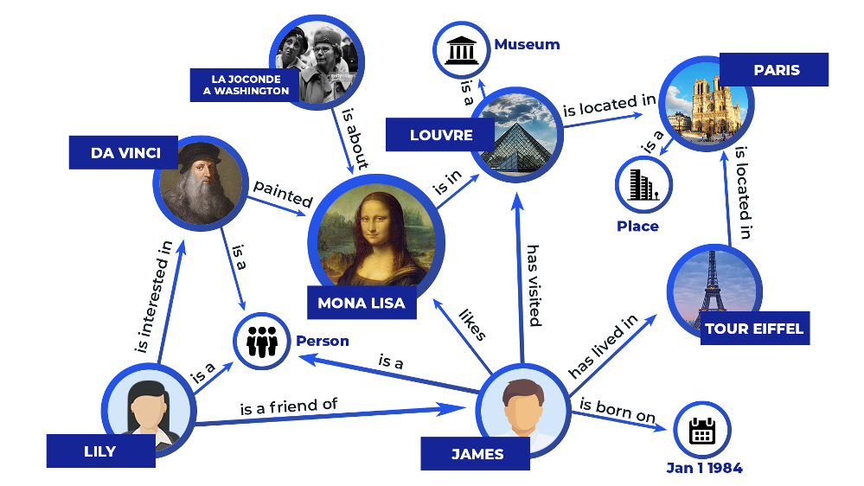
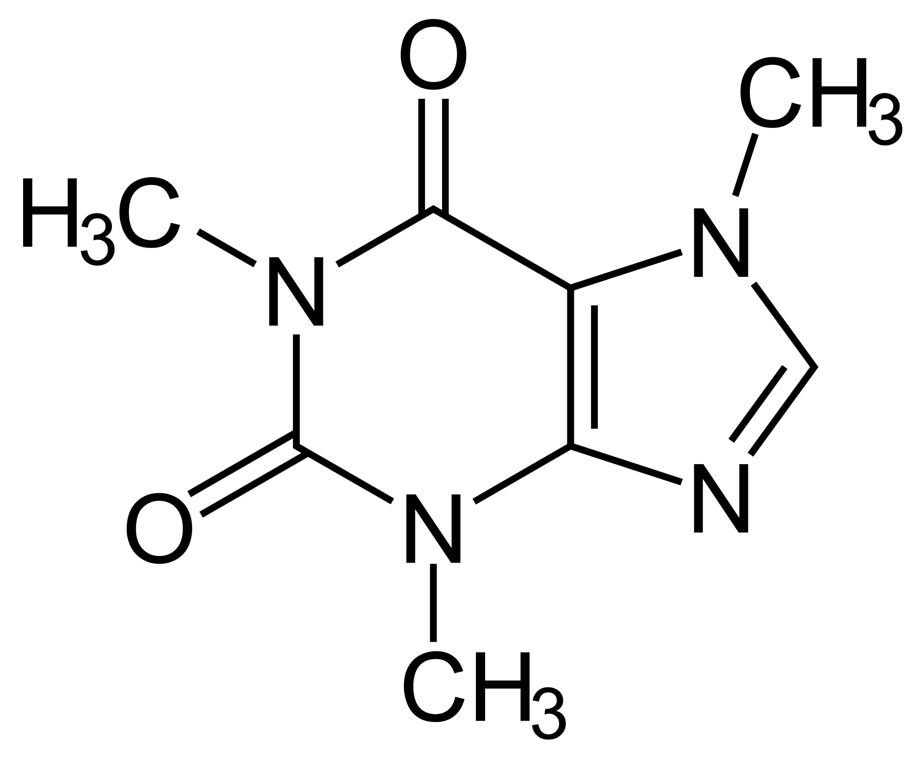
Graph generation?
So far, we’ve assumed the graph is given
Models predict probability of node/edge/graph label or regression value
Can we generate graphs instead?
Image credit: vertabelo
Image credit: Chemistry StackExchange
Image credit: Zilliz

Slide 10
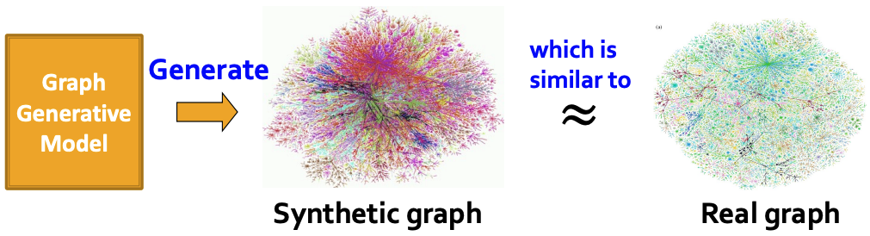
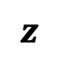
Graph generation?
Goal is to generate realistic graphs (i.e., graphs similar in distribution to graphs in our data)
$$z$$
0
1
1
0
1
Image credit: Jure Leskovec, http://cs224w.stanford.edu

Slide 11
Graph generation motivation
Benchmarking graph methods (e.g., community detection)
Epistemology of graph/network formulation
Prediction of graph evolution (e.g., how will social networks evolve over time)
Simulation of novel graphs (e.g., novel drugs)
Anomaly detection (e.g., unusual user behavior)

Slide 12
Traditional graph generation methods

Slide 13
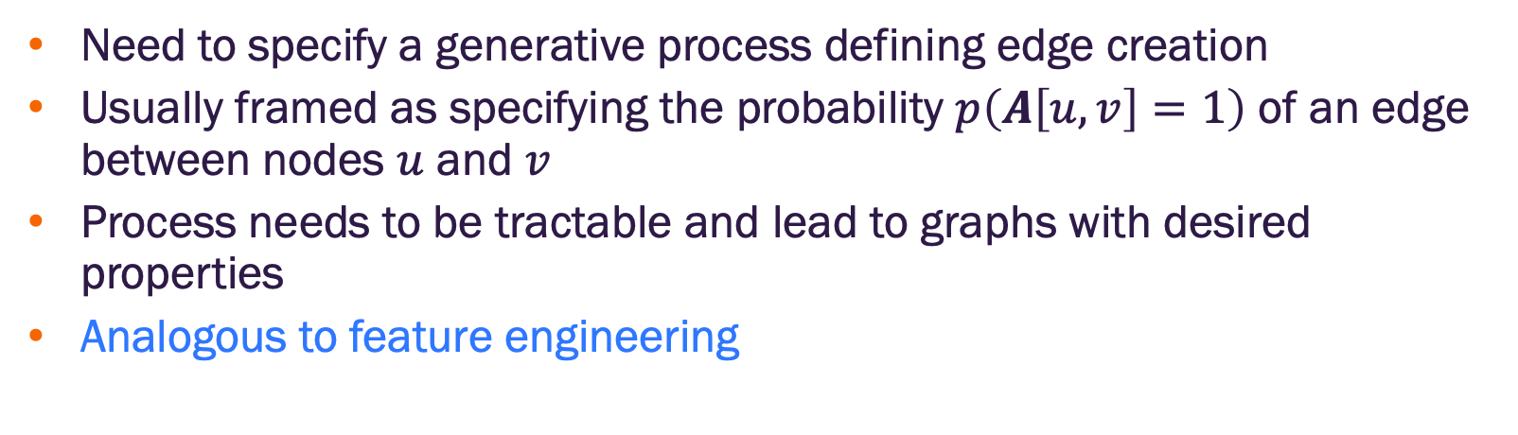
Traditional approach
Need to specify a generative process defining edge creation
Usually framed as specifying the probability $p\left(A\left[u,v\right]=1\right)$ of an edge between nodes $u$ and $v$
Process needs to be tractable and lead to graphs with desired properties
Analogous to feature engineering

Slide 14
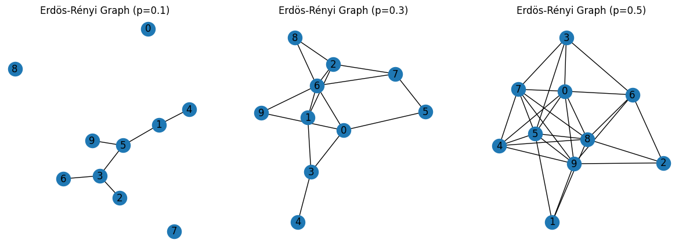
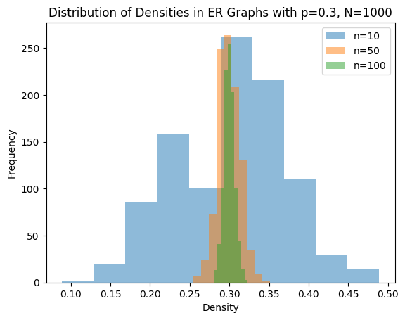
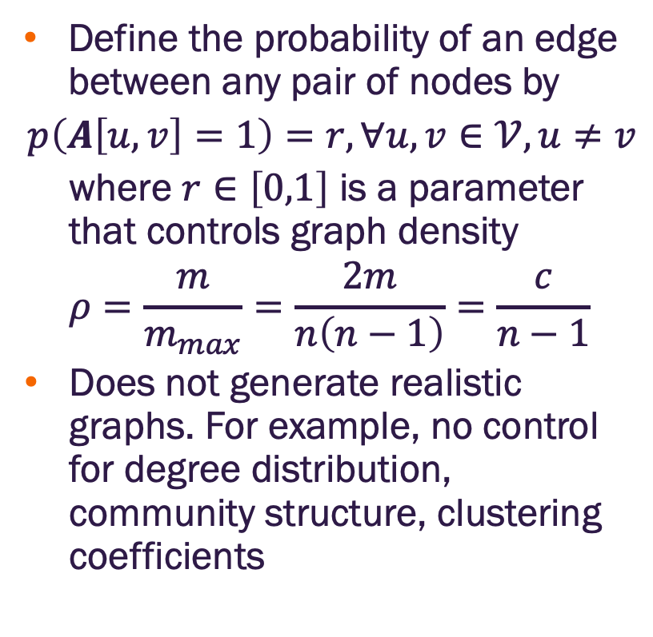
Erdös-Rényi model
Define the probability of an edge between any pair of nodes by
$$p\left(A\left[u,v\right]=1\right)=r, ∀u,v∈𝒱,u≠v$$
where $r∈\left[0,1\right]$ is a parameter that controls graph density
$$ρ=\frac{m}{m_{max}}=\frac{2m}{n\left(n−1\right)}=\frac{c}{n−1}$$
Does not generate realistic graphs. For example, no control for degree distribution, community structure, clustering coefficients
Notes:
Erdos – pronounced “Err-dish”
Renyi – pronounced ”ren - E”

Slide 15
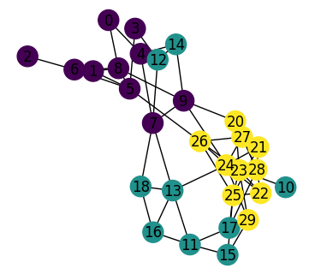
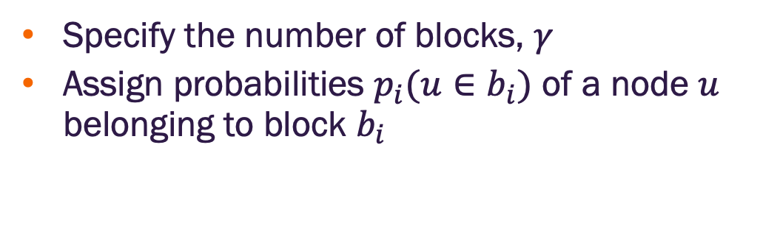
Stochastic block models
Specify the number of blocks, $γ$
Assign probabilities $p_{i}(u∈b_{i})$ of a node $u$ belonging to block $b_{i}$
SBM generated graph with three (3) blocks
Notes:
Erdos – pronounced “Err-dish”
Renyi – pronounced ”ren - E”

Slide 16
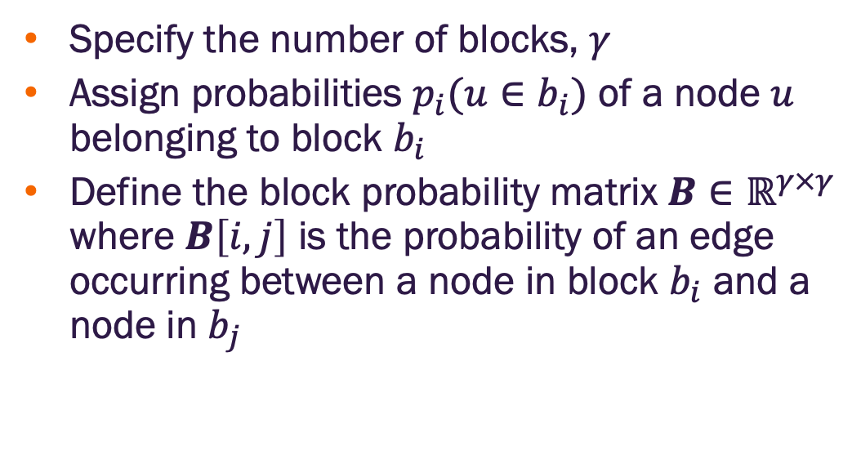
Stochastic block models
Specify the number of blocks, $γ$
Assign probabilities $p_{i}(u∈b_{i})$ of a node $u$ belonging to block $b_{i}$
Define the block probability matrix $B∈ℝ^{γ×γ}$ where $B\left[i,j\right]$ is the probability of an edge occurring between a node in block $b_{i}$ and a node in $b_{j}$
SBM generated graph with three (3) blocks
Notes:
Erdos – pronounced “Err-dish”
Renyi – pronounced ”ren - E”

Slide 17
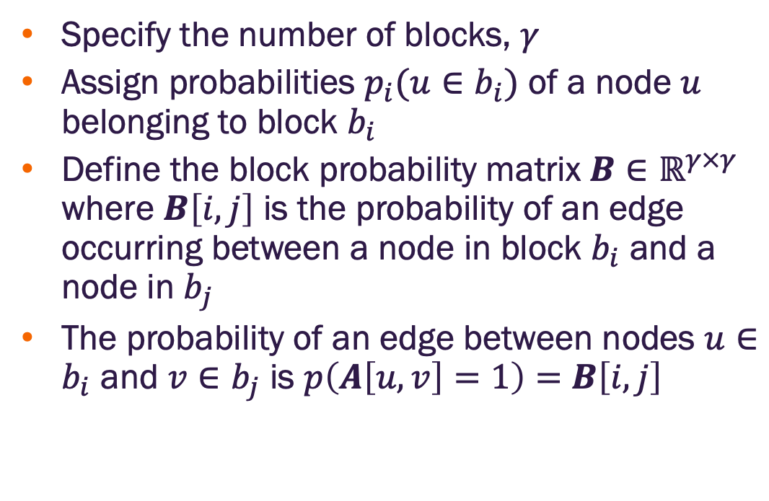
Stochastic block models
Specify the number of blocks, $γ$
Assign probabilities $p_{i}(u∈b_{i})$ of a node $u$ belonging to block $b_{i}$
Define the block probability matrix $B∈ℝ^{γ×γ}$ where $B\left[i,j\right]$ is the probability of an edge occurring between a node in block $b_{i}$ and a node in $b_{j}$
The probability of an edge between nodes $u∈b_{i}$ and $v∈b_{j}$ is $p\left(A\left[u,v\right]=1\right)=$ $B\left[i,j\right]$
SBM generated graph with three (3) blocks
Notes:
Erdos – pronounced “Err-dish”
Renyi – pronounced ”ren - E”

Slide 18
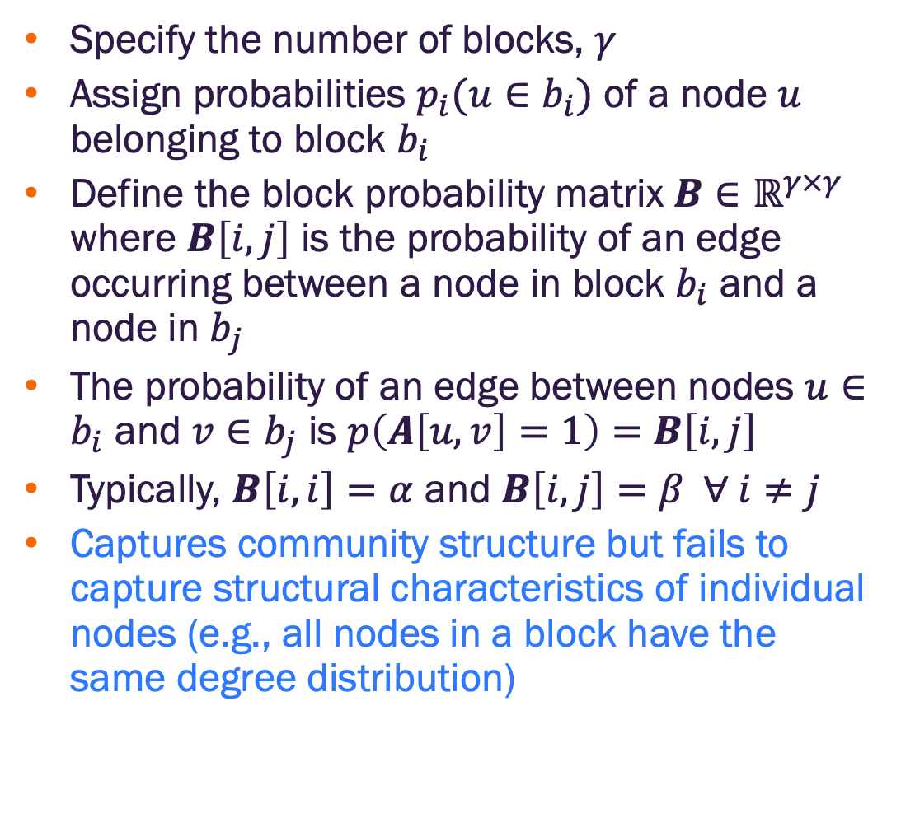
Stochastic block models
Specify the number of blocks, $γ$
Assign probabilities $p_{i}(u∈b_{i})$ of a node $u$ belonging to block $b_{i}$
Define the block probability matrix $B∈ℝ^{γ×γ}$ where $B\left[i,j\right]$ is the probability of an edge occurring between a node in block $b_{i}$ and a node in $b_{j}$
The probability of an edge between nodes $u∈b_{i}$ and $v∈b_{j}$ is $p\left(A\left[u,v\right]=1\right)=$ $B\left[i,j\right]$
Typically, $B\left[i,i\right]=α$ and $B\left[i,j\right]=β ∀ i≠j$
Captures community structure but fails to capture structural characteristics of individual nodes (e.g., all nodes in a block have the same degree distribution)
SBM generated graph with three (3) blocks
Notes:
Erdos – pronounced “Err-dish”
Renyi – pronounced ”ren - E”

Slide 19
Preferential attachment
Attempts to model node degree distributions observed in real-world graphs

Slide 20
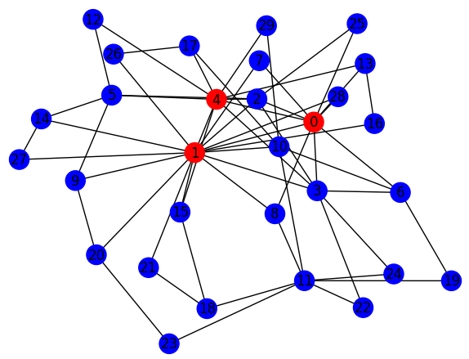
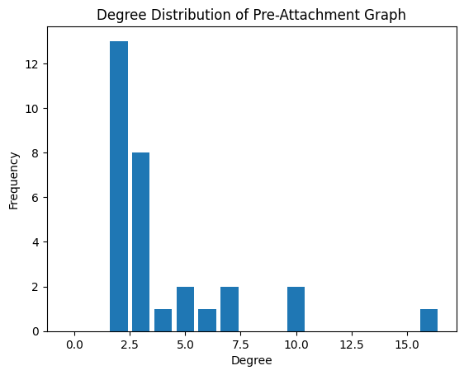
Preferential attachment
Attempts to model node degree distributions observed in real-world graphs
Generates graphs that exhibit power-law (heavy tail) distributions where most nodes have low degree but some have very large degree

Slide 21
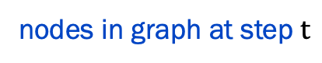
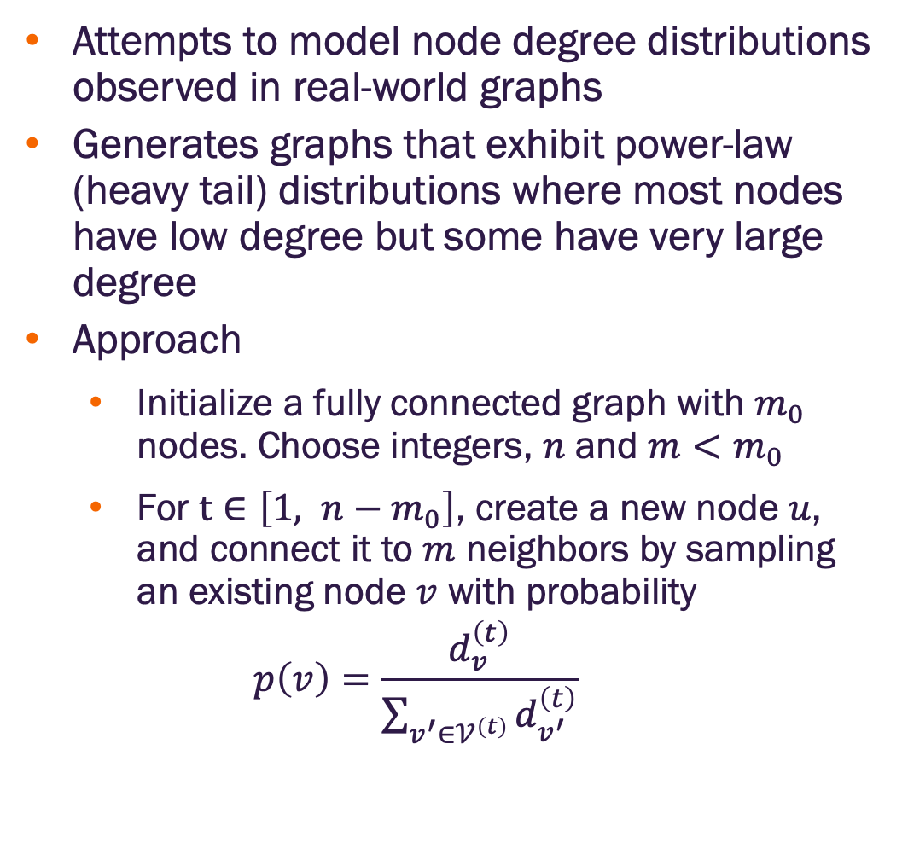
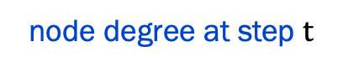
Preferential attachment
Attempts to model node degree distributions observed in real-world graphs
Generates graphs that exhibit power-law (heavy tail) distributions where most nodes have low degree but some have very large degree
Approach
Initialize a fully connected graph with $m_{0}$ nodes. Choose integers, $n$ and $m<m_{0}$
For $t∈\left[1, n−m_{0}\right]$, create a new node $u$, and connect it to $m$ neighbors by sampling an existing node $v$ with probability
$$p\left(v\right)=\frac{d_{v}^{\left(t\right)}}{\sum_{v^{′}∈𝒱^{\left(t\right)}}{d_{v^{′}}^{\left(t\right)}}}$$
node degree at step $t$
nodes in graph at step $t$

Slide 22
Deep generative models

Slide 23
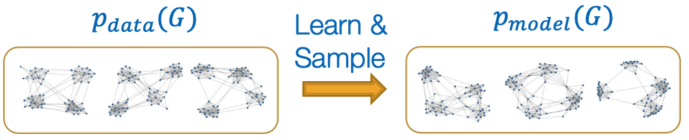
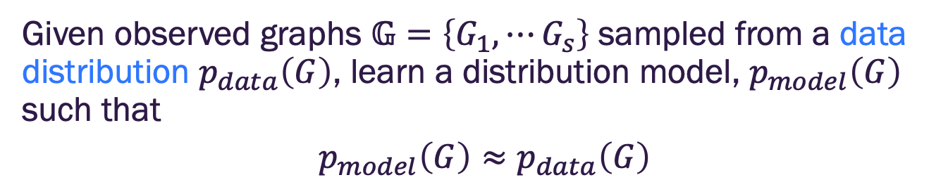
Graph generative model
Given observed graphs $𝔾=\left\{G_{1},⋯G_{s}\right\}$ sampled from a data distribution $p_{data}\left(G\right)$, learn a distribution model, $p_{model}\left(G\right)$ such that
$$p_{model}\left(G\right)≈p_{data}\left(G\right)$$
Data distribution is generally unknown. We only have observed samples
Image credit: Jure Leskovec, http://cs224w.stanford.edu

Slide 24
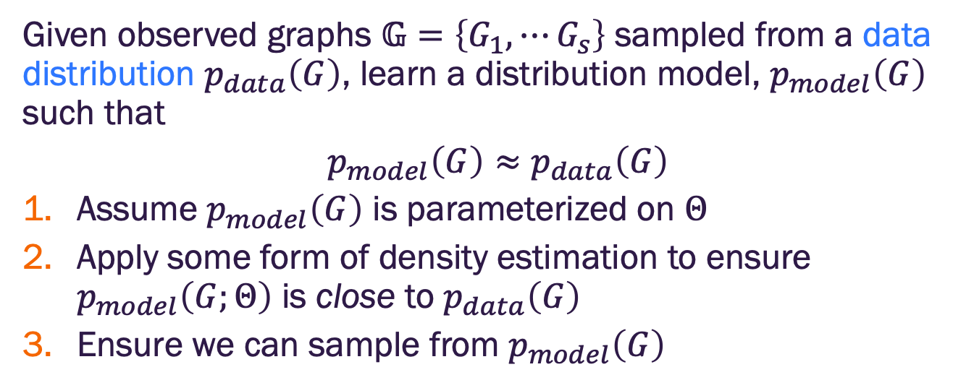
Graph generative model
Given observed graphs $𝔾=\left\{G_{1},⋯G_{s}\right\}$ sampled from a data distribution $p_{data}\left(G\right)$, learn a distribution model, $p_{model}\left(G\right)$ such that
$$p_{model}\left(G\right)≈p_{data}\left(G\right)$$
Assume $p_{model}\left(G\right)$ is parameterized on $Θ$
Apply some form of density estimation to ensure $p_{model}\left(G;Θ\right)$ is close to $p_{data}\left(G\right)$
Ensure we can sample from $p_{model}\left(G\right)$
Data distribution is generally unknown. We only have observed samples
Image credit: Jure Leskovec, http://cs224w.stanford.edu

Slide 25
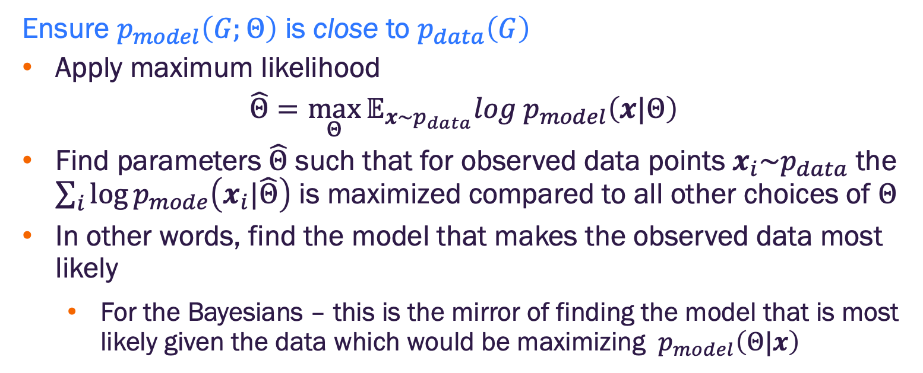
Graph generative modeling
Ensure $p_{model}\left(G;Θ\right)$ is close to $p_{data}\left(G\right)$
Apply maximum likelihood
$$\hat{Θ}=\max_{Θ}{𝔼_{x\sim p_{data}}log{ p}_{model}\left(x|Θ\right)}$$
Find parameters $\hat{Θ}$ such that for observed data points $x_{i}\sim p_{data}$ the $\sum_{i}{\log{p_{mode}\left(x_{i}|\hat{Θ}\right)}}$ is maximized compared to all other choices of $Θ$
In other words, find the model that makes the observed data most likely
For the Bayesians – this is the mirror of finding the model that is most likely given the data which would be maximizing ${ p}_{model}\left(Θ|x\right)$

Slide 26
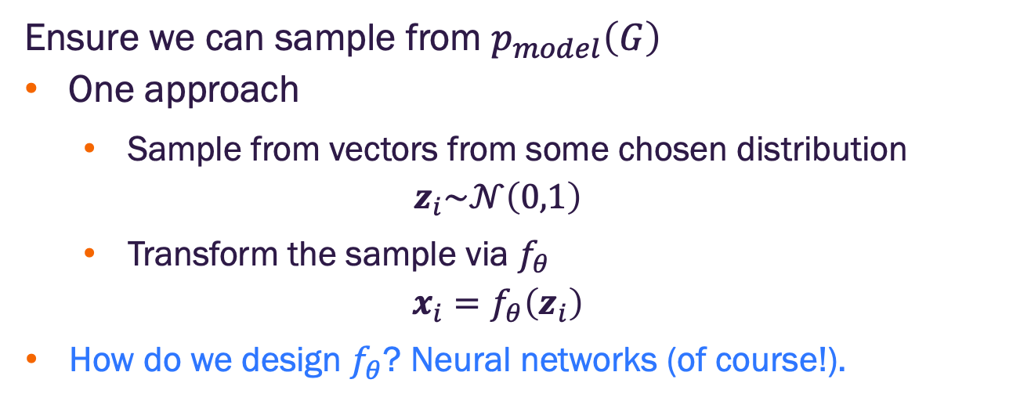
Graph generative modeling
Ensure we can sample from $p_{model}\left(G\right)$
One approach
Sample from vectors from some chosen distribution
$$z_{i}\sim 𝒩\left(0,1\right)$$
Transform the sample via $f_{θ}$
$$x_{i}=f_{θ}\left(z_{i}\right)$$
How do we design $f_{θ}$? Neural networks (of course!).

Slide 27
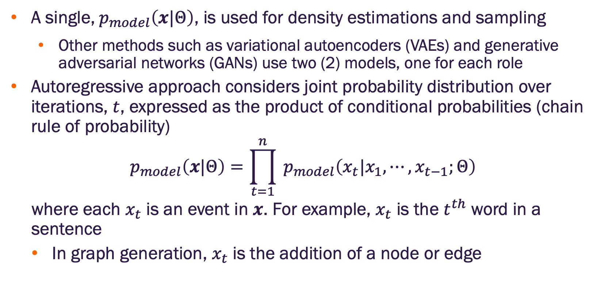
Autoregressive models
A single,${ p}_{model}\left(x|Θ\right)$, is used for density estimations and sampling
Other methods such as variational autoencoders (VAEs) and generative adversarial networks (GANs) use two (2) models, one for each role
Autoregressive approach considers joint probability distribution over iterations, $t$, expressed as the product of conditional probabilities (chain rule of probability)
$${ p}_{model}\left(x|Θ\right)=\prod_{t=1}^{n}{{ p}_{model}\left(x_{t}|x_{1},⋯,x_{t−1};Θ\right)}$$
where each $x_{t}$ is an event in $x$. For example, $x_{t}$ is the $t^{th}$ word in a sentence
In graph generation, $x_{t}$ is the addition of a node or edge
How can we implement this?

Slide 28
Graphs as sequences

Slide 29
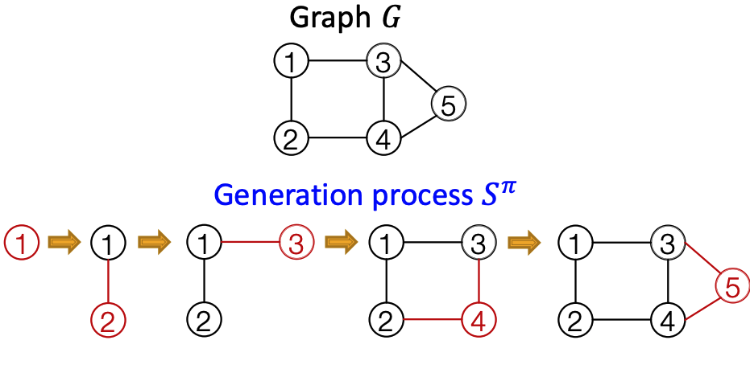
Graph generation as a sequence
Generate graphs via sequentially adding nodes and edges
Image credit: You et al 2018, https://proceedings.mlr.press/v80/you18a

Slide 30
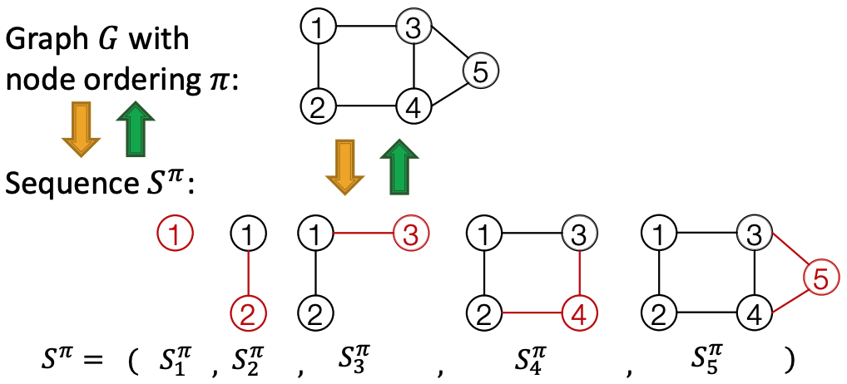
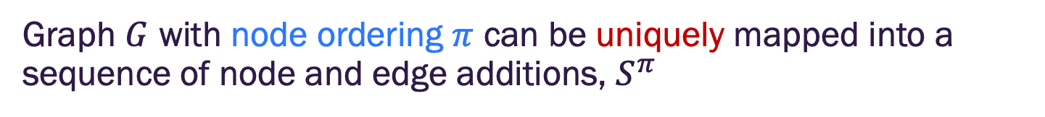
Graph generation as a sequence
Graph $G$ with node ordering $π$ can be uniquely mapped into a sequence of node and edge additions, $S^{π}$
Image credit: Jure Leskovec, http://cs224w.stanford.edu

Slide 31


Graph generation as a sequence
The sequence, $S^{π}$, has two levels (i.e., it is a sequence of sequences)
Node level: add nodes one at a time
Edge level: add edges between new node and existing nodes
Node level: At each step, add a new node
Image credit: Jure Leskovec, http://cs224w.stanford.edu

Slide 32


Graph generation as a sequence
The sequence, $S^{π}$, has two levels (i.e., it is a sequence of sequences)
Node level: add a new node
Each node-level step creates an edge-level sequence
Edge level: Sequence of edge additions for the new node
Add node 4. Create sequence indicating addition of edges between node 4 and existing edges
Image credit: Jure Leskovec, http://cs224w.stanford.edu

Slide 33







Graph generation as a sequence
The sequence, $S^{π}$, has two levels (i.e., it is a sequence of sequences)
Node level: add a new node
Each node-level step creates an edge-level sequence
Edge level: Sequence of edge additions for the new node
$S_{1}^{π}$,
$$S_{2}^{π},$$
$$S_{3}^{π},$$
$$S_{4}^{π},$$
$$S_{5}^{π}$$
$S_{i}^{π}$ is a vector of size $i−1$ whose elements $s_{ij}^{π}$ indicate if there is a edge between node $i$ and node $j$ where $j<i$
$$S^{π}=$$
1
1
1
0
1
1
0
0
1
1
Image credit: Jure Leskovec, http://cs224w.stanford.edu

Slide 34





Graph generation as a sequence
A graph plus a node ordering → a sequence of sequences
Node ordering is randomly selected (we’ll revisit this)
Why does this matter?
Transformed graph generation into sequence generation
$$S_{2}^{π}$$
$$S_{3}^{π}$$
$$S_{4}^{π}$$
$$S_{5}^{π}$$
Image credit: Jure Leskovec, http://cs224w.stanford.edu

Slide 35
Graph generation as a sequence
Transformed graph generation into sequence generation
Can model this as two processes
Generate a state for a new node (node-level sequence)
Generate edges for the new node based on its state
Can use recurrent neural networks (RNNs) to model these processes
Could also use Transformers
Image credit: Jure Leskovec, http://cs224w.stanford.edu

Slide 36
GraphRNN

Slide 37

Recurrent neural network (RNN) review
RNNs are designed for sequential data
Sequentially process input elements to update RNN hidden state
The hidden state summarizes previous inputs of the sequence
The output and hidden state update are created via RNN cells
Image credit: Jure Leskovec, http://cs224w.stanford.edu

Slide 38



Recurrent neural network (RNN) review
$s_{t}$: State of RNN after step $t$
$x_{t}$: Input to RNN at step $t$
$y_{t}$: Output of RNN at step $t$
More expressive RNN cells include GRUs, LSTM, xLSTM
Basic (vanilla) RNN Cell
Hidden state update
$$s_{t}=σ\left(Wx_{t}+Us_{t−1}\right)$$
Output
$$y_{t}=Vs_{t}$$
Image credit: Jure Leskovec, http://cs224w.stanford.edu

Slide 39

GraphRNN: Two levels of RNN
GraphRNN has a node level RNN and an edge level RNN
Relationship between the two RNNs:
Node level RNN generates the initial state for the edge level RNN
Edge level RNN sequentially predicts if the new node is connected to each of the previous nodes

Slide 40
GraphRNN for graph sequence generation
Issues to address:
How to initialize the hidden state and input sequence for the node level RNN? We don’t have any nodes yet.
How to generate the sequence with stochastic sampling?
How to conduct training?
Creating a new graph?

Slide 41
GraphRNN for graph sequence generation
Issues to address:
How to initialize the hidden state and input sequence for the node level RNN? We don’t have any nodes yet.
Initialize hidden node level state as a zero vector and input with Start of Sequence (SOS) vector (usually zeros or ones)
Provide output of node level as initial state of edge level RNN and input with SOS (this will repeat for every new node)

Slide 42
GraphRNN for graph sequence generation
Issues to address:
✔️ How to initialize the hidden state and input sequence for the node level RNN? We don’t have any nodes yet.
How to generate the sequence with stochastic sampling?
How to conduct training?
Creating a new graph?

Slide 43


Edge sequence generation
Consider the edge level RNN for now
Our goal is to model $\prod_{t=1}^{n}{{ p}_{model}\left(x_{t}|x_{1},⋯,x_{t−1};Θ\right)}$
Let $x_{t}$ be the event that an edge is added between the new node and an existing node
Image credit: Jure Leskovec, http://cs224w.stanford.edu

Slide 44

Edge sequence generation
Let $x_{t}$ be the event that an edge is added between the new node and an existing node
We want the edge level RNN output $y_{t}={ p}_{model}\left(x_{t+1}|x_{1},⋯,x_{t};Θ\right)$
We can then stochastically add edges by sampling $x_{t+1}$ from $y_{t}$
Image credit: Jure Leskovec, http://cs224w.stanford.edu

Slide 45


Edge sequence generation
Assume the edge level RNN is already trained
Interpret $y_{t}$ as the probability of success in a Bernoulli distribution
$y_{t}=p$ below indicates value 1 (add edge) has probability $p$, value 0 (no edge) has probability $1−p$
Sample a random number, $r$, from a uniform distribution on $\left[0,1\right]$
If $r≤y_{t}$ add an edge, otherwise no edge
Repeat for all nodes currently in the graph
Stochastic process generates a sample $S_{i}^{π}$ of edges between new node $i$ and nodes $j$ in the current graph.
Image credit: Jure Leskovec, http://cs224w.stanford.edu

Slide 46
GraphRNN for graph sequence generation
Issues to address:
✔️ How to initialize the hidden state and input sequence for the node level RNN? We don’t have any nodes yet.
✔️ How to generate the sequence with stochastic sampling?
How to conduct training?
Creating a new graph?

Slide 47

Edge level RNN training
Training the model
Observe a training sample with a sequence of edges $\left[0, 0, 1, ⋯\right]$
Apply teaching forcing principle – at each step replace the predicted output with the actual value (training only)
Teaching forcing principle leads to faster training and improved convergence (usually) for RNNs

Slide 48


Edge level RNN training
Training the model
Observe a training sample with a sequence of edges $\left[0, 0, 1, ⋯\right]$
Apply teaching forcing principle – at each step replace the predicted output with the actual value (training only)
Image credit: Jure Leskovec, http://cs224w.stanford.edu

Slide 49

Edge level RNN training
Minimize binary cross entropy loss
$$ℒ=−\left[y_{1}^{∗}log\left(y_{1}\right)+\left(1−y_{1}^{∗}\right)log\left(1−y_{1}\right)\right]$$
For every pair of nodes in a training graph:
If $y_{1}^{∗}=1$ (an edge is present), minimize $−log\left(y_{1}\right)$ so $y_{1}$ increases
If $y_{1}^{∗}=0$ (no edge is present), minimize $−log\left({1−y}_{1}\right)$ so $y_{1}$ decreases
$y_{1}$ is fitting to the training samples – learned edge probability distribution should match data distribution
Remember $y_{1}$ is computed by the combined RNNs, so the loss gradients will adjust RNN parameters

Slide 50

GraphRNN generation plan
Initialization
$S_{1}^{π}=SOS$ (node 1 doesn’t have previous nodes to connect)
$h_{1}=empty$ (Node RNN initial state)
$i=1$
Generation
$i=i+1$
Add a new node: Run the Node RNN to generate output $x_{i}$ and updated state $h_{i}$
Generate $S_{i}^{π}$: Run the Edge RNN to predict if the next new node will connect to existing nodes (including the new node from step 2)
If $S_{i}^{π}=EOS$→Stop
Else: go to step 1

Slide 51


GraphRNN generation plan
Generation
$i=i+1$
Add a new node: Run the Node RNN to generate output $x_{i}$ and updated state $h_{i}$
Generate $S_{i}^{π}$: Run the Edge RNN to predict if the next new node will connect to existing nodes (including the new node from step 2)
If $S_{i}^{π}=EOS$→Stop
Else: go to step 1
Note: $S_{i}^{π}$ are the predicted edge values for the next new node. For example, for $i=2$, after step 2, there is one (1) node in the graph (created at step 1). $S_{2}^{π}=\left[s\right]$where $s∈\left[0,1\right]$ indicates whether node 2, if created, will connect to node 1.
Why predict ahead? If the EOS is generated in this iteration, we want the node state vector, $h_{i}$, to represent the graph with its current nodes.

Slide 52








GraphRNN training
Training sample
Generated graph
3
Initial state: $S_{1}^{π}=SOS$, $h_{1}=empty$
1
1
2
$S_{1}^{π}=$SOS
Node RNN
$$h_{1}$$
$$h_{2}$$
Initialize hidden state
Edge RNN
SOS
$$EOS=0$$
$$x_{1}=0.5$$
Apply teacher forcing to make $S_{2}^{π}$ match observed graph
Stochastically sample from a Bernoulli with $p=x_{1}$
$$S_{2}^{π}=\left[1\right]$$

Slide 53




GraphRNN training
Training sample
Generated graph
3
Current state: $S_{2}^{π}=\left[1\right]$, $h_{2}$→1 node
1
1
2
2
$S_{1}^{π}=$SOS
Node RNN
Node RNN
$$h_{1}$$
$$h_{2}$$
$$h_{2}$$
$$h_{3}$$
Initialize hidden state
Edge RNN
Edge RNN
SOS
$$EOS=0$$
$$x_{1}=0.5$$
SOS
$$EOS=0$$
$$x_{1}=0.6$$
probability next node would connect with node 1
Stochastically sample from a Bernoulli with $p=x_{1}$
$$S_{2}^{π}=\left[1\right]$$

Slide 54





GraphRNN training
Training sample
Generated graph
3
Current state: $S_{2}^{π}=\left[1\right]$, $h_{2}$→1 node
1
1
2
2
$S_{1}^{π}=$SOS
Node RNN
Node RNN
$$h_{1}$$
$$h_{2}$$
$$h_{2}$$
$$h_{3}$$
Initialize hidden state
Edge RNN
Edge RNN
SOS
$$EOS=0$$
$$x_{1}=0.5$$
SOS
$$EOS=0$$
$$x_{1}=0.6$$
probability next node would connect with node 1
$$h_{3}^{∗}$$
$$1$$
Apply teacher forcing to make input match observed graph
Stochastically sample from a Bernoulli with $p=x_{1}$
Edge RNN
$$S_{2}^{π}=\left[1\right]$$
$$x_{2}=0.4$$
probability next node would connect with node 2
$$S_{3}^{π}=\left[\begin{matrix}1 \\ 0\end{matrix}\right]$$

Slide 55




GraphRNN training
Training sample
Generated graph
3
3
Current state: $S_{3}^{π}=\left[\begin{matrix}1 \\ 0\end{matrix}\right]$, $h_{3}$→2 nodes
1
1
2
2
$S_{1}^{π}=$SOS
Node RNN
Node RNN
Node RNN
$$h_{1}$$
$$h_{2}$$
$$h_{3}$$
$$h_{2}$$
$$h_{3}$$
Initialize hidden state
$$h_{4}$$
Edge RNN
Edge RNN
Edge RNN
SOS
$$EOS=0$$
$$x_{1}=0.5$$
SOS
$$EOS=0$$
$$x_{1}=0.6$$
$$EOS=1$$
$$x_{1}=0.4$$
SOS
$$h_{3}^{∗}$$
$$1$$
Stochastically sample from a Bernoulli with $p=x_{1}$
Edge RNN
EOS generated. Stop generation process
$$S_{2}^{π}=\left[1\right]$$
$$x_{2}=0.4$$
$$S_{3}^{π}=\left[\begin{matrix}1 \\ 0\end{matrix}\right]$$

Slide 56















GraphRNN training
Training sample
Generated graph
3
3
Backprop through time. Loss gradients accumulated across iterations.
Update parameters
1
1
2
2
$S_{1}^{π}=$SOS
Node RNN
Node RNN
Node RNN
$$h_{1}$$
$$h_{2}$$
$$h_{3}$$
$$h_{2}$$
$$h_{3}$$
Initialize hidden state
$$h_{4}$$
Edge RNN
Edge RNN
Edge RNN
SOS
$$EOS=0$$
$$x_{1}=0.5$$
SOS
$$EOS=0$$
$$x_{1}=0.6$$
$$EOS=1$$
$$x_{1}=0.4$$
SOS
$$1$$
$$h_{3}^{∗}$$
$$1$$
Edge RNN
EOS generated. Stop generation process
$$x_{2}=0.4$$
$$0$$

Slide 57
GraphRNN for graph sequence generation
Issues to address:
✔️ How to initialize the hidden state and input sequence for the node level RNN? We don’t have any nodes yet.
✔️ How to generate the sequence with stochastic sampling?
✔️ How to conduct training?
Creating a new graph?

Slide 58


GraphRNN graph generation
Generated graph
3
Current state: $S_{3}^{π}=\left[\begin{matrix}1 \\ 0\end{matrix}\right]$, $h_{3}$→2 nodes
1
2
$S_{1}^{π}=$SOS
Node RNN
Node RNN
Node RNN
$$h_{1}$$
$$h_{2}$$
$$h_{3}$$
$$h_{2}$$
$$h_{3}$$
$$h_{4}$$
Edge RNN
Edge RNN
Edge RNN
SOS
$$EOS=0$$
$$x_{1}=0.5$$
SOS
$$EOS=0$$
$$x_{1}=0.6$$
$$EOS=1$$
$$x_{1}=0.4$$
SOS
$$h_{3}^{∗}$$
Stochastically sample from a Bernoulli with $p=x_{1}$
Edge RNN
EOS generated. Stop generation process
$$S_{2}^{π}=\left[1\right]$$
$$x_{2}=0.4$$
Stochastically sample from a Bernoulli with $p=x_{j}$ for $s_{3,j}^{π}$
$$S_{3}^{π}=\left[\begin{matrix}0 \\ 1\end{matrix}\right]$$

Slide 59


GraphRNN graph generation
Generated graph
3
Current state: $S_{3}^{π}=\left[\begin{matrix}1 \\ 0\end{matrix}\right]$, $h_{3}$→2 nodes
1
2
$S_{1}^{π}=$SOS
Node RNN
Node RNN
Node RNN
$$h_{1}$$
$$h_{2}$$
$$h_{3}$$
$$h_{2}$$
$$h_{3}$$
$$h_{4}$$
Edge RNN
Edge RNN
Edge RNN
SOS
$$EOS=0$$
$$x_{1}=0.5$$
SOS
$$EOS=0$$
$$x_{1}=0.6$$
$$EOS=1$$
$$x_{1}=0.4$$
SOS
$$h_{3}^{∗}$$
Stochastically sample from a Bernoulli with $p=x_{1}$
Edge RNN
EOS generated. Stop generation process
$$S_{2}^{π}=\left[0\right]$$
$$x_{2}=0.4$$
Stochastically sample from a Bernoulli with $p=x_{j}$ for $s_{3,j}^{π}$
$$S_{3}^{π}=\left[\begin{matrix}1 \\ 0\end{matrix}\right]$$

Slide 60
GraphRNN for graph sequence generation
Issues to address:
✔️ How to initialize the hidden state and input sequence for the node level RNN? We don’t have any nodes yet.
✔️ How to generate the sequence with stochastic sampling?
✔️ How to conduct training?
✔️ Creating a new graph?

Slide 61
Evaluation

Slide 62

Evaluating generated graphs
How to compare two sets of graphs
Approaches
Visual inspection (qualitative)
Statistical metrics
Image credit: Jure Leskovec, http://cs224w.stanford.edu

Slide 63

Visual similarity
Image credit: Hamilton, 2020, Graph Representation Learning

Slide 64

Statistical measures
Compare univariate statistics of the generated graphs against a test set
Assume we have a set of graph statistics $S=\left\{s_{1},⋯,s_{n}\right\}$ where each statistic $s_{i,G}:ℝ⟶\left[0,1\right]$ defines a univariate distribution over $ℝ$ for a given graph $G$.
Compute the distance between the distributions for the test graph and the generated graph using a distributional measure such total variation distance (TVD)
$$d\left(s_{i,G_{test}},s_{i,G_{gen}}\right)=\sup_{x∈ℝ}\left|s_{i,G_{test}}\left(x\right)−s_{i,G_{gen}}\left(x\right)\right|$$
TVD = 0 → perfect match
TVD = 1 → no match

Slide 65

Statistical measures example
Calculate the node degree for all nodes in $G$
Form the degree distribution.
For each observed degree, $d$, find the number of nodes, $n_{d}$, with that degree.
The statistic $s_{i,G}\left(d\right)={n_{d}}/{\left|G\right|}$ where $\left|G\right|$ is the number of nodes in $G$
Compute the toval variational distance (TVD)
$$d\left(s_{i,G_{test}},s_{i,G_{gen}}\right)=\sup_{x∈ℝ}\left|s_{i,G_{test}}\left(x\right)−s_{i,G_{gen}}\left(x\right)\right|$$
For each observed degree, calculate the absolute difference between $s_{i,G}\left(d\right)={n_{d}}/{\left|G\right|}$ for the test graph and generated graph and take the maximum.
Repeat across multiple graphs to get a mean

Slide 66


